Slide 1
IN THE NAME OF GOD
ASTHMA & COPD
Dr. Somaye Fatahian
INTERNIST

Slide 2
ASTHMA

Slide 3
MANIFESTATIONS
EPIDEMIOLOGY

Slide 4
THE PATHWAY TO THE DEVELOPMENT OF ASTHMA

Slide 7
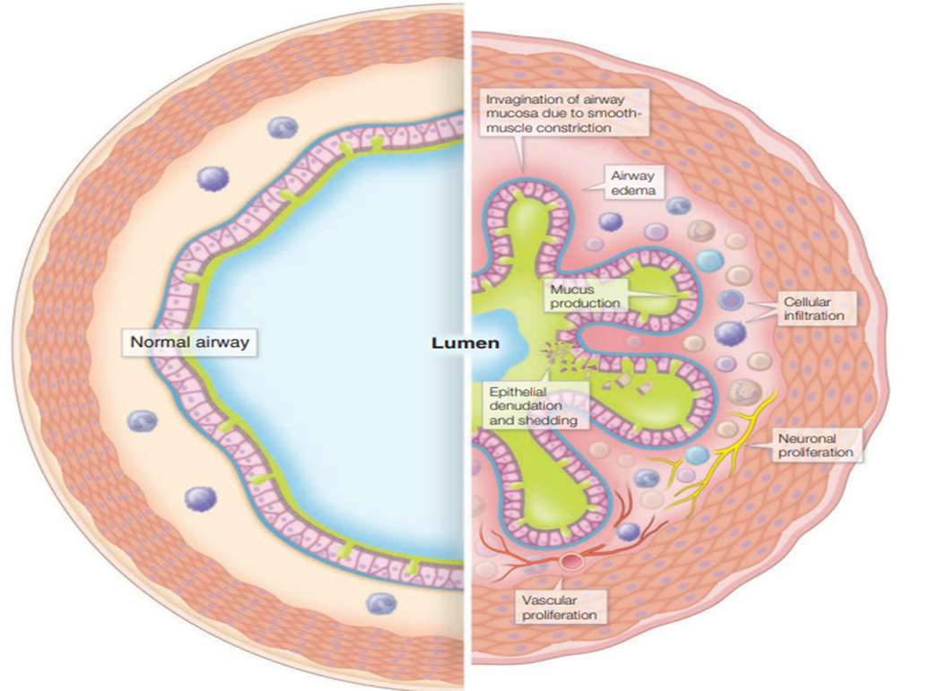
PATHOPHYSIOLOGY

Slide 8
MECHANISMS LEADING TO ACUTE AND CHRONIC AIRWAY OBSTRUCTION
Airway Hyperresponsiveness
Inflammatory Cells
Airway Smooth Muscle
Subepithelial Collagen Deposition and Matrix Deposition
Airway Epithelium
Vascular Proliferation
Airway Edema
Epithelial Goblet Cell Metaplasia and Mucus Hypersecretion
Neuronal Proliferation

Slide 9
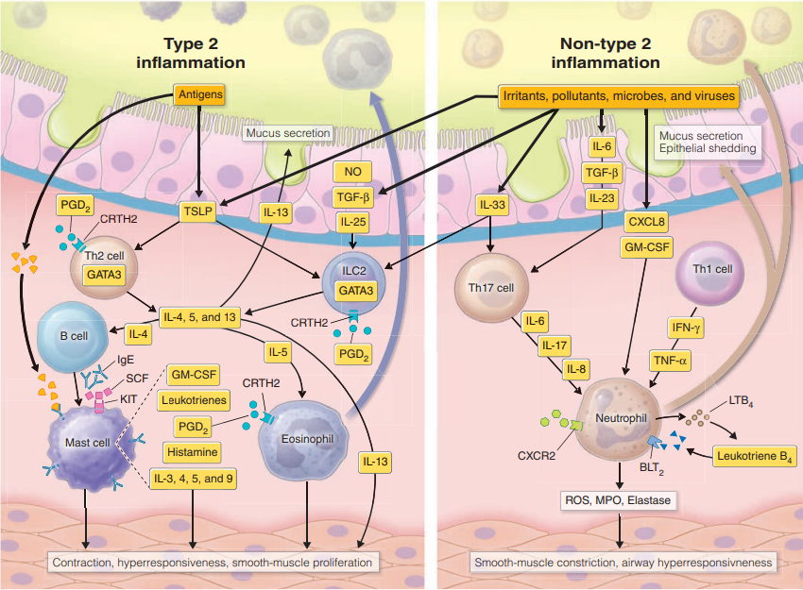
AIRWAY INFLAMMATION (TYPE 2 AND NON–TYPE 2 INFLAMMATION)
Type 2 Inflammation
Non–Type 2 Processes

Slide 10
MEDIATORS
Cytokines
Fatty Acid Mediators
Nitric Oxide
Reactive Oxygen Species
Chemokines

Slide 11
ETIOLOGIC MECHANISMS, RISK FACTORS, TRIGGERS, AND COMPLICATING COMORBIDITIES
HERITABLE PREDISPOSITION

Slide 12
EXPOSURES AND RISK FACTORS
Allergic Sensitization and Allergen Exposure
Tobacco
Air Pollution
Infections
Occupational Exposures
Diet
Obesity

Slide 13
EXPOSURES AND RISK FACTORS
High-Concentration Irritant Exposure and RADS
Fungi and Allergic Airway Mycoses
Exercise-Induced Symptoms in Elite Athletes
Medications
Prenatal and Perinatal Risk Factors
Endogenous Developmental Risk Factors

Slide 14
TRIGGERS OF AIRWAY NARROWING
Allergens
Irritants
Viral Infections
Exercise and Cold/Dry Air
Air Pollution
Drugs
Occupational Exposures
Stress
Hormonal Factors

Slide 15
COMORBIDITIES
Obesity
Gastroesophageal Reflux Disease
Rhinosinusitis And/Or Nasal Polyposis
Vocal Cord Dysfunction
Chronic Obstructive Pulmonary Disease (COPD)
Anxiety/Depression

Slide 17
DIAGNOSIS AND EVALUATION
APPROACH
PRIMARY ASSESSMENT TOOLS FOR ESTABLISHING A DIAGNOSIS
History
Physical Examination
Pulmonary Function Tests
Assessment of Airway Responsiveness

Slide 18
ADJUNCTIVE ASSESSMENT TOOLS
Eosinophil Counts
IgE, Skin Tests, and Radioallergosorbent Tests
Exhaled Nitric Oxide
ADDITIONAL EVALUATION IN SEVERE/ POORLY RESPONSIVE ASTHMA
Chest Radiography
Sputum

Slide 19
TREATMENT
GOALS OF ASTHMA THERAPY AND ASSESSMENT OF CONTROL
REDUCING TRIGGERS
Mitigation
Allergen Immunotherapy
Vaccination

Slide 21
MEDICATIONS
Bronchodilators
Short-Acting $β_{2}$-Agonists
Long-Acting $β_{2}$-Agonists
Ultra Long-Acting $β_{2}$-Agonists
Anticholinergics
Theophylline

Slide 22
Controller (Anti-Inflammatory/Antimediator) Therapies
Corticosteroids
ICS and ICS/LABA
Oral Corticosteroids
Intravenous Corticosteroids
Intramuscular Corticosteroids

Slide 23
Leukotriene Modifiers
CysLT1 Antagonists
5-Lipoxygenase Inhibition
Cromolyn Sodium
Anti-IgE
IL-5–Active Drugs
Anti–IL-4/13

Slide 24
Bronchial Thermoplasty, Alternative Therapies, and Therapies Under Development
Bronchial Thermoplasty
Alternative Therapies
Therapies in Development

Slide 25
APPROACH TO THE PATIENT

Slide 26
Asthma Attacks

Slide 27
HIGH-RISK ASTHMA PATIENTS

Slide 28
EXERCISE-INDUCED SYMPTOMS
PREGNANCY
ASPIRIN-EXACERBATED RESPIRATORY DISEASE
SEVERE ASTHMA
ELDERLY PATIENTS WITH ASTHMA
ASTHMA-COPD OVERLAP

Slide 29
CHRONIC OBSTRUCTIVE PULMONARY DISEASE

Slide 30
PATHOGENESIS
INFLAMMATION AND EXTRACELLULAR MATRIX PROTEOLYSIS
Cell Death
Ineffective Repair

Slide 32
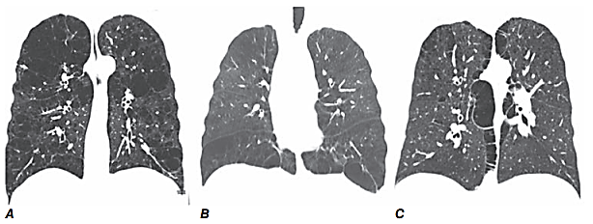
PATHOLOGY
LARGE AIRWAYS
SMALL AIRWAYS
LUNG PARENCHYMA

Slide 34
PATHOPHYSIOLOGY
AIRFLOW OBSTRUCTION
HYPERINFLATION
GAS EXCHANGE

Slide 35
RISK FACTORS
CIGARETTE SMOKING
AIRWAY RESPONSIVENESS AND COPD
RESPIRATORY INFECTIONS
OCCUPATIONAL EXPOSURES
AMBIENT AIR POLLUTION
PASSIVE, OR SECOND-HAND, SMOKING EXPOSURE
GENETIC CONSIDERATIONS
$α_{1}$ Antitrypsin Deficiency
Other Genetic Risk Factors

Slide 37
NATURAL HISTORY

Slide 38
CLINICAL PRESENTATION
HISTORY
PHYSICAL FINDINGS
LABORATORY FINDINGS

Slide 39
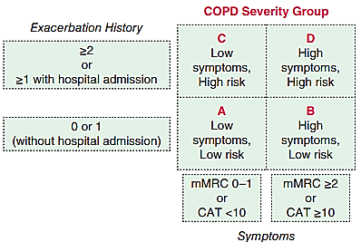
TREATMENT
STABLE PHASE COPD

Slide 40
PHARMACOTHERAPY
Smoking Cessation
Bronchodilators
Muscarinic Antagonists
Beta Agonists
Combinations of Beta Agonist–Muscarinic Antagonist
Inhaled Corticosteroids

Slide 41
PHARMACOTHERAPY
PDE4 Inhibitors
Antibiotics
Oxygen
$α_{1}$ AT Augmentation Therapy
Oral Glucocorticoids
Theophylline

Slide 42
NONPHARMACOLOGIC THERAPIES
Pulmonary Rehabilitation
Lung Volume Reduction Surgery
Lung Transplantation

Slide 43
EXACERBATIONS OF COPD
Precipitating Causes and Strategies to Reduce Frequency of Exacerbations
Patient Assessment

Slide 44
TREATMENT OF ACUTE EXACERBATIONS
Bronchodilators
Antibiotics
Oxygen
Mechanical Ventilatory Support

Slide 47
THANKS FOR YOUR ATTENTION

